Slide 1


Evaluating the Probability of Infection In a UK Hospice Through A CFD Driven Metric and Experimental Validation
Mohammad Elsarraj, Yasser Mahmoudi & Amir Keshmiri
School of Engineering, University of Manchester, M13 9PL, UK

Slide 2
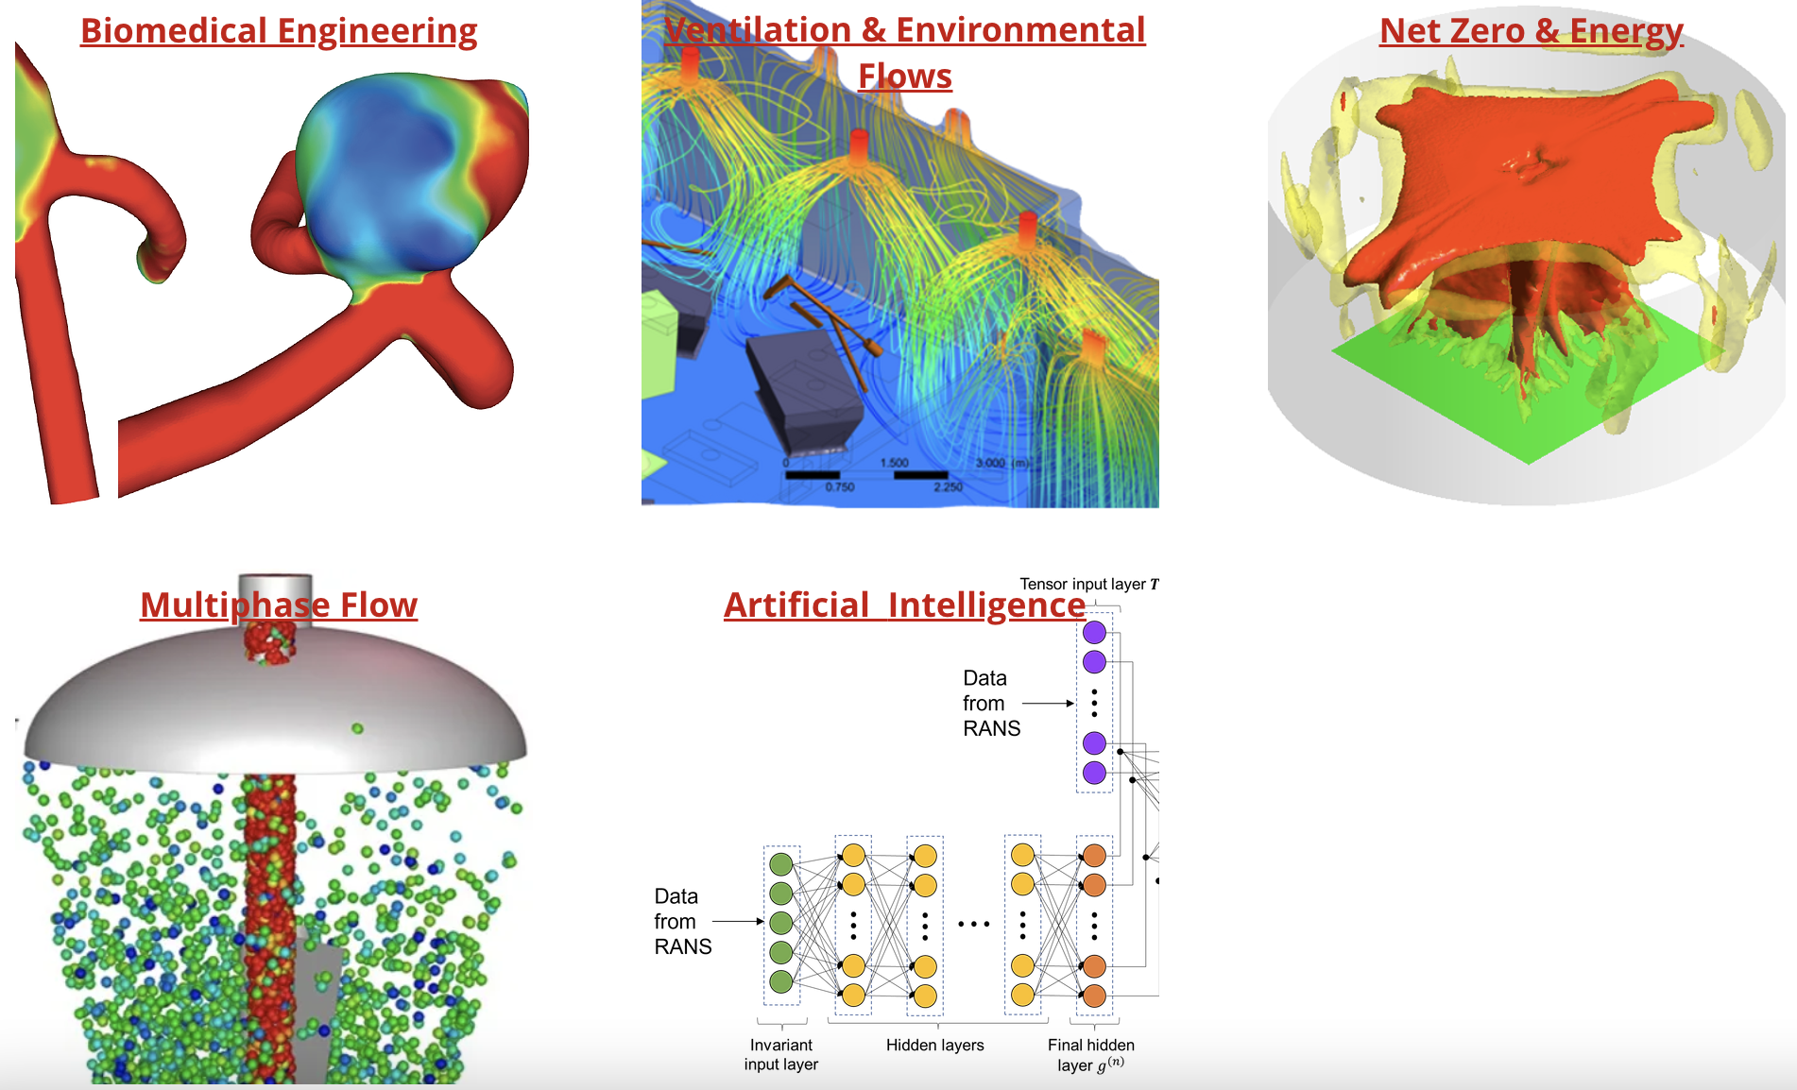

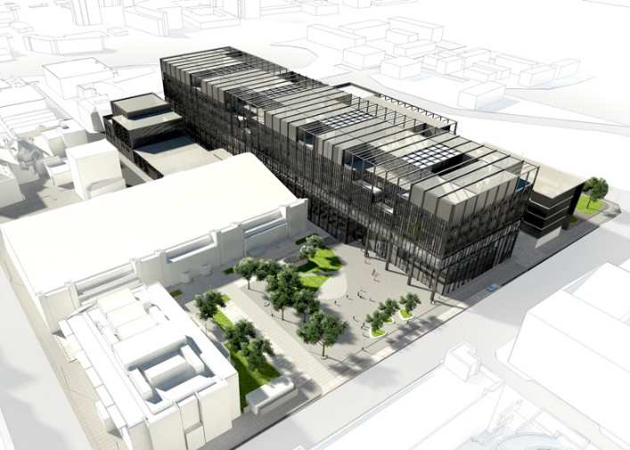

Our Expertise
www.ManchesterCFD.co.uk

Slide 3



ManchesterCFD Team’s Commercial Activities
www.HeliRidgeGraft.com www.theCASP.com www.Nano-Syn.tech
www.Thermocill.com
www.AffordableHealthTech.com
www.VerXisWind.com

Slide 4
Introduction

Slide 5

Infection Risk in Indoor Spaces
The COVID-19 pandemic exposed the vulnerability of indoor environments to airborne disease transmission.
Airborne transmission remains a critical challenge in enclosed environments like offices, hospitals, and schools.
Smaller aerosol particles (<5 μm) can remain suspended and travel far, unlike larger droplets that settle quickly.
Ventilation plays a crucial role in reducing infection risk and preventing cross-infection
The pandemic has highlighted the importance of robust infection risk (IR) assessment and mitigation strategies.
It exposed major limitations in current infection risk (IR) assessment methods, which often oversimplify transmission mechanisms.

Slide 6
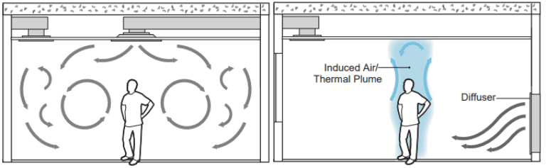
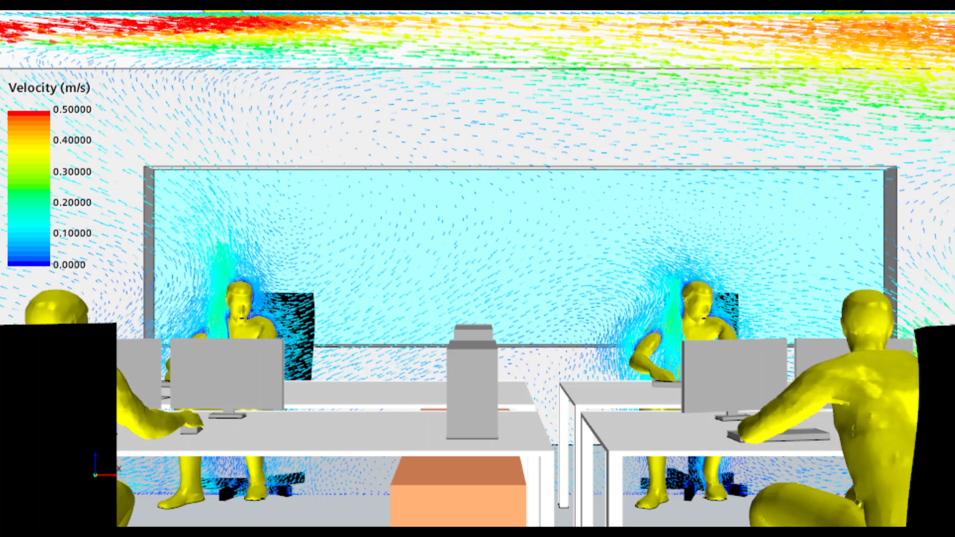
Ventilation
Mixing Ventilation
Displacement Ventilation
Purpose of Ventilation:
To remove indoor pollutants and replace stale air with fresh outdoor air in rooms, zones, or entire buildings.
Mixing Ventilation:
Actively mixes fresh air throughout the space to ensure uniform air quality.
Displacement Ventilation:
Gently pushes out contaminated air by introducing fresh air at low levels.
Relies on buoyancy-driven, laminar flow to minimise disruption.

Slide 7
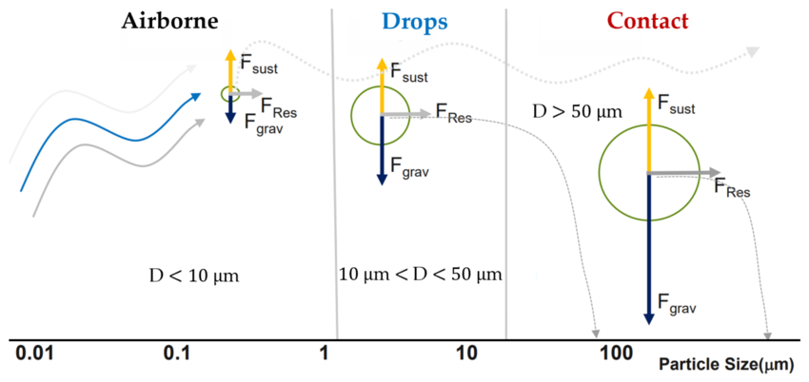
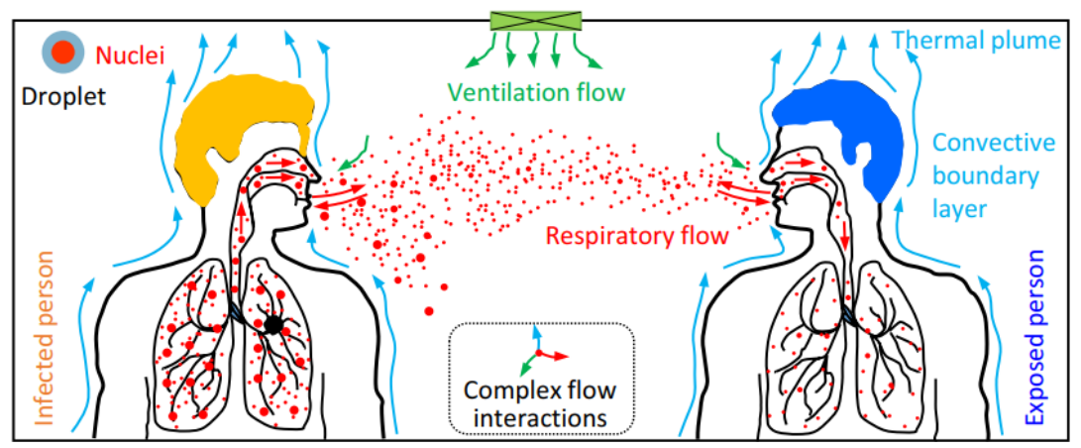
Exhaled Particle Mechanics

Slide 8
Methodology

Slide 9

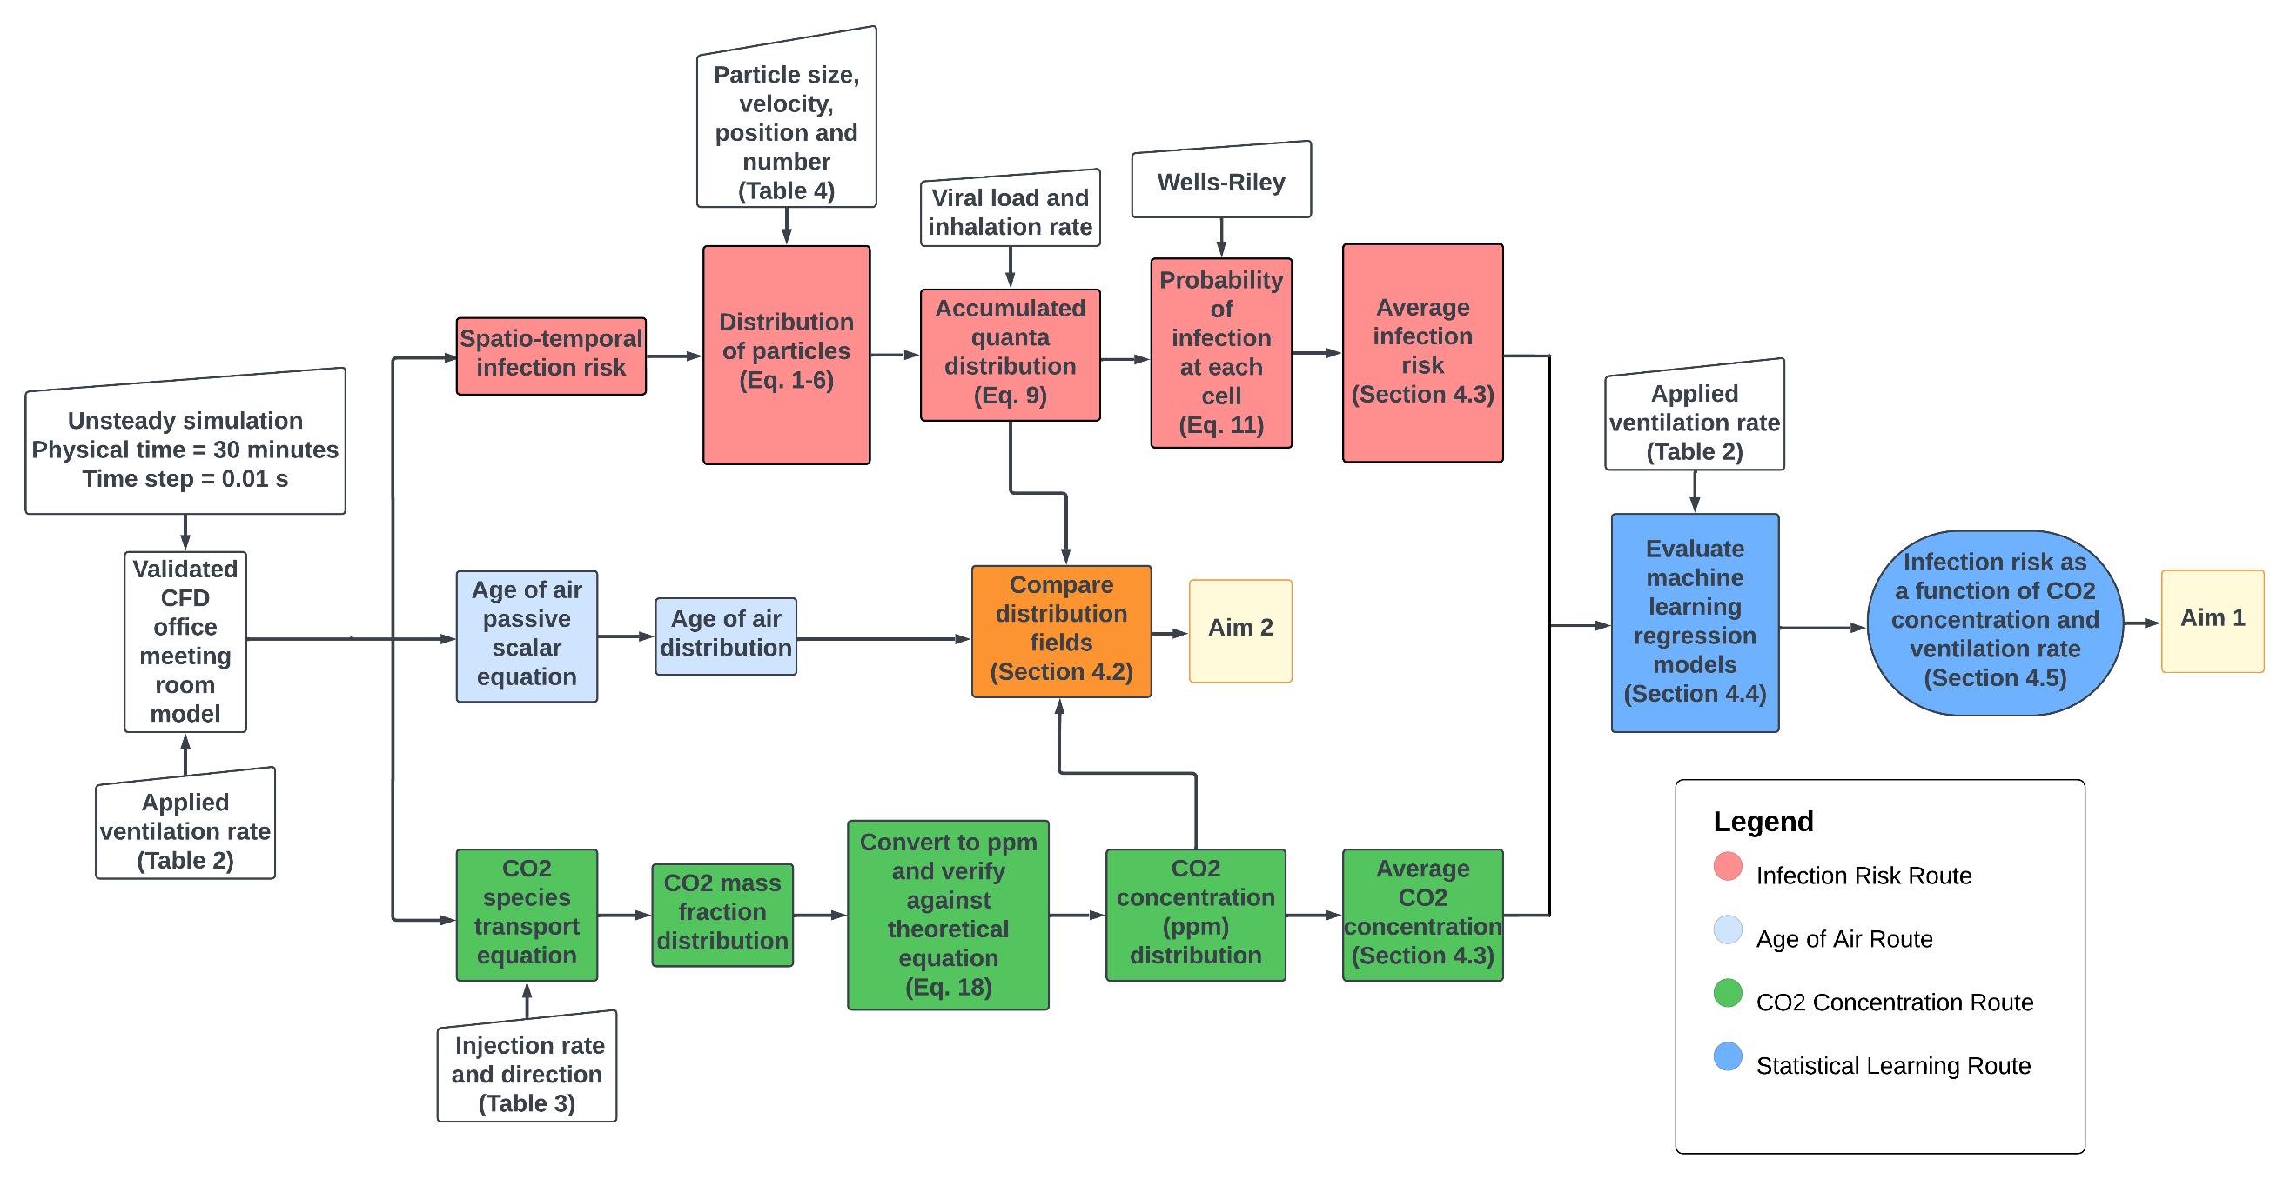
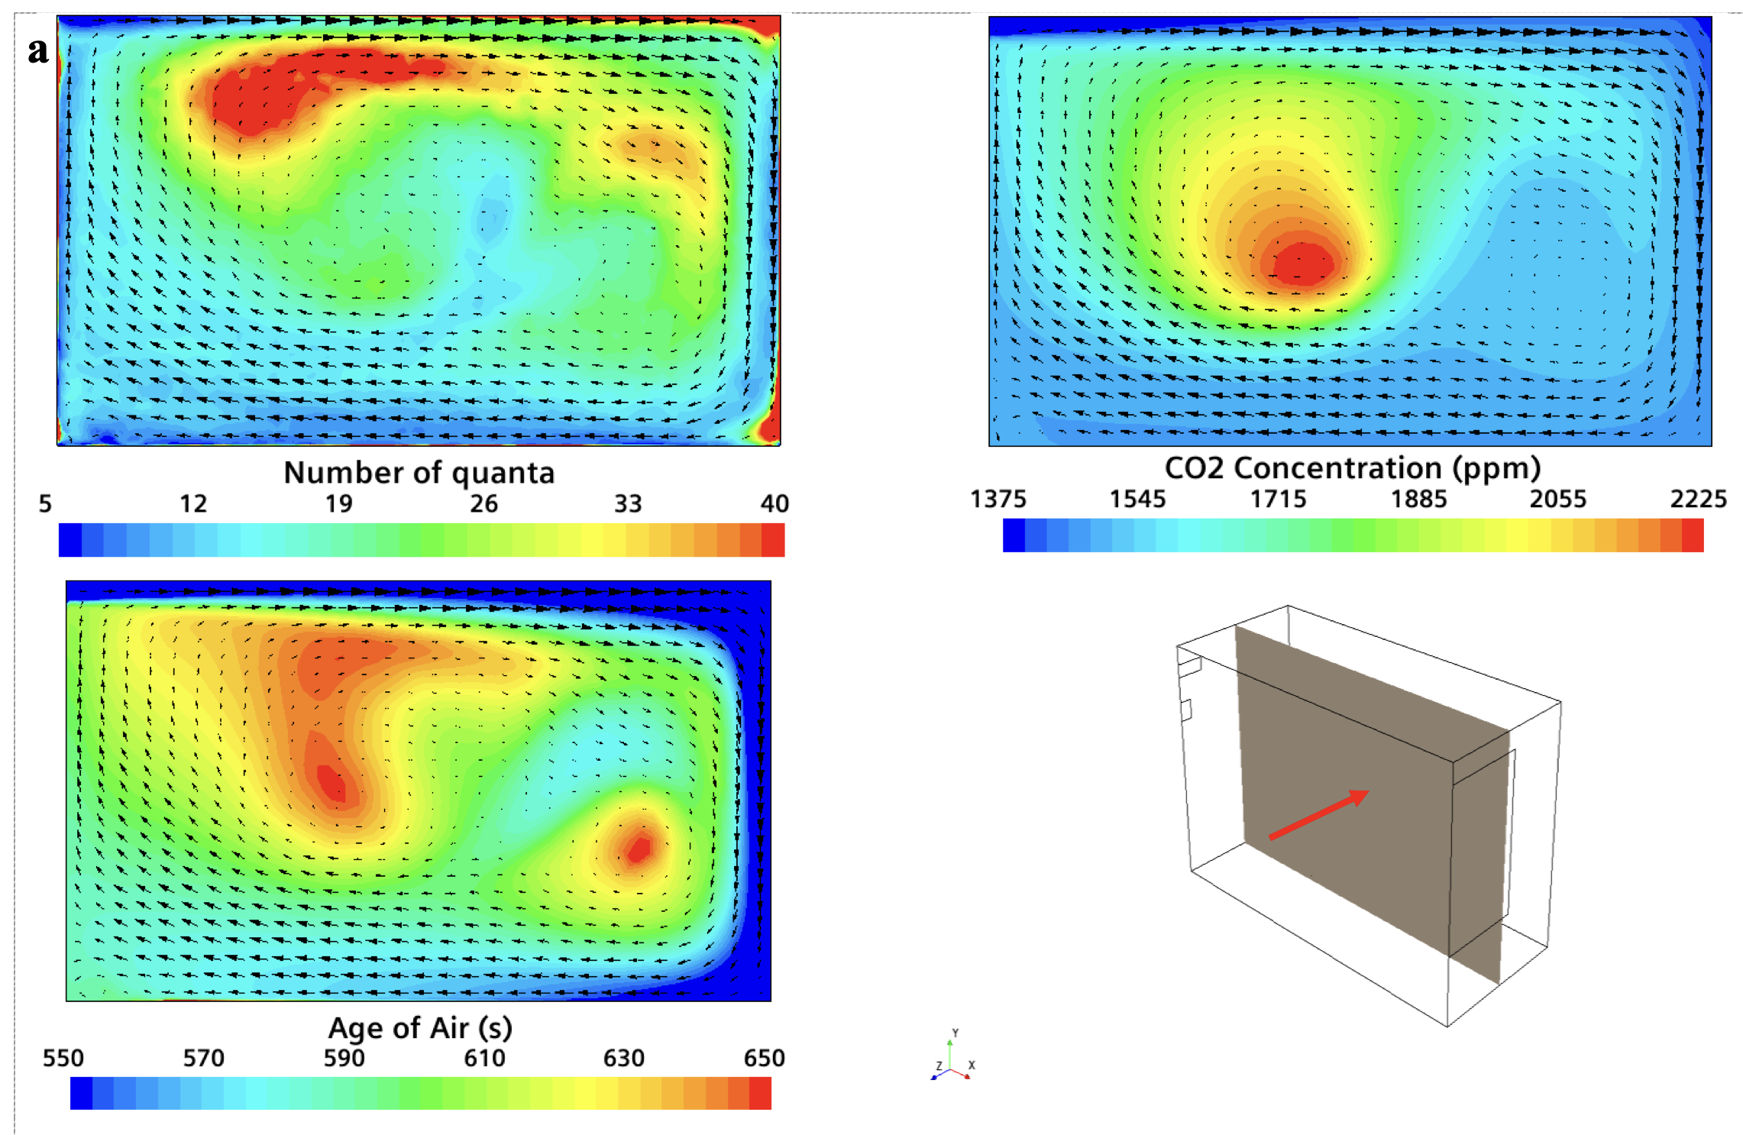

Slide 10
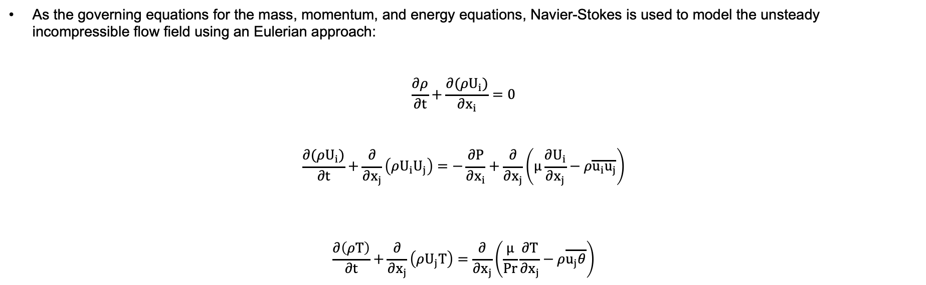
The Eulerian Model
As the governing equations for the mass, momentum, and energy equations, Navier-Stokes is used to model the unsteady incompressible flow field using an Eulerian approach:
$$\frac{∂ρ}{∂t}+\frac{∂(ρU_{i})}{∂x_{i}}=0$$
$$\frac{∂(ρU_{i})}{∂t}+\frac{∂}{∂x_{j}}\left(ρ{U_{i}U}_{j}\right)=−\frac{∂P}{∂x_{i}}+\frac{∂}{∂x_{j}}\left(µ\frac{∂U_{i}}{∂x_{j}}−ρ\overline{u_{i}u_{j}}\right)$$
$$\frac{∂\left(ρT\right)}{∂t}+\frac{∂}{∂x_{j}}\left(ρU_{j}T\right)=\frac{∂}{∂x_{j}}\left(\frac{µ}{Pr}\frac{∂T}{∂x_{j}}−ρ\overline{u_{j}θ}\right)$$
where, $ρ$ is the density and $\overline{u_{j}θ}$ is the turbulent heat flux vector, respectively.

Slide 11
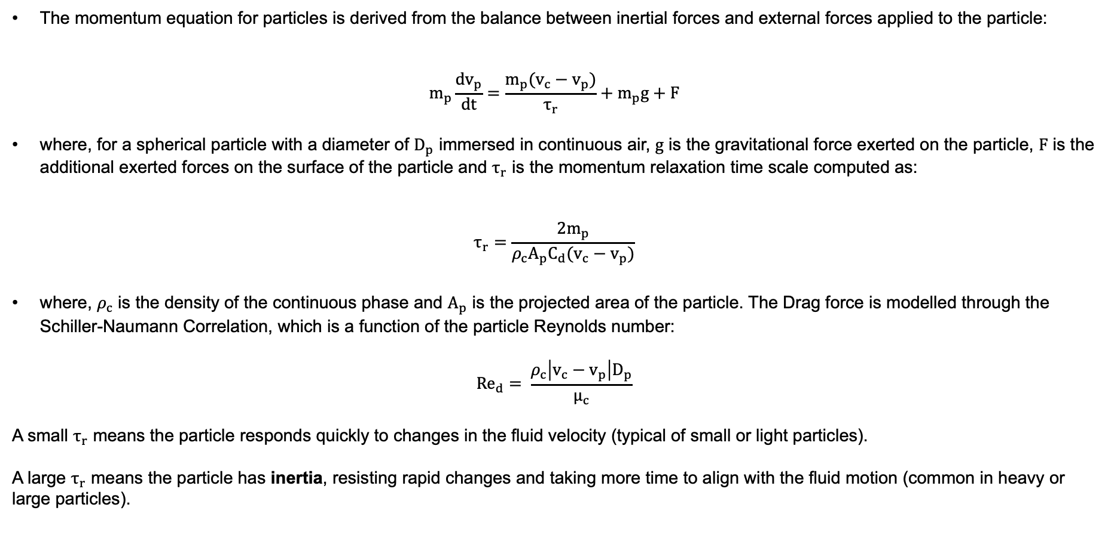
The Lagrangian Model
The momentum equation for particles is derived from the balance between inertial forces and external forces applied to the particle:
$$m_{p}\frac{dv_{p}}{dt}=\frac{m_{p}(v_{c}−v_{p})}{τ_{r}}+m_{p}g+F$$
where, for a spherical particle with a diameter of $D_{p}$ immersed in continuous air, $g$ is the gravitational force exerted on the particle, $F$ is the additional exerted forces on the surface of the particle and $τ_{r}$ is the momentum relaxation time scale computed as:
$$τ_{r}=\frac{{2m}_{p}}{{ρ_{c}A}_{p}C_{d}(v_{c}−v_{p})}$$
where, $ρ_{c}$ is the density of the continuous phase and $A_{p}$ is the projected area of the particle. The Drag force is modelled through the Schiller-Naumann Correlation, which is a function of the particle Reynolds number:
$${Re}_{d}= \frac{ρ_{c}\left|v_{c}−v_{p}\right|D_{p}}{μ_{c}}$$
A small $τ_{r}$ means the particle responds quickly to changes in the fluid velocity (typical of small or light particles).
A large $τ_{r}$​ means the particle has inertia, resisting rapid changes and taking more time to align with the fluid motion (common in heavy or large particles).

Slide 12
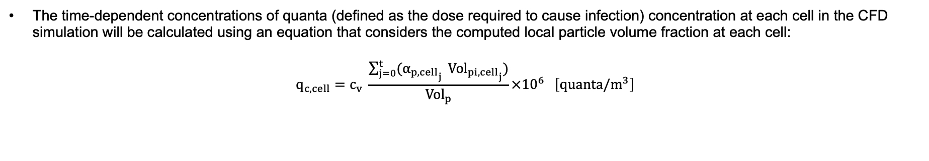
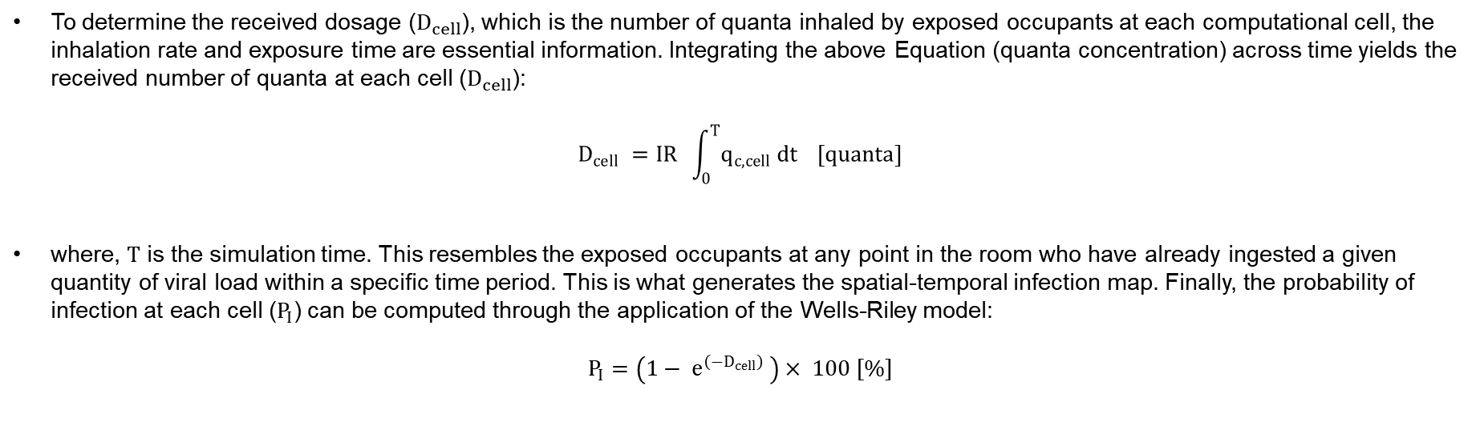
Infection Risk Metric
Virion Concentration at each Cell
The time-dependent concentrations of quanta (defined as the dose required to cause infection) concentration at each cell in the CFD simulation will be calculated using an equation that considers the computed local particle volume fraction at each cell:
$$q_{c,cell}=c_{v} \frac{\sum_{j=0}^{t}{{(α_{p,cell}}_{j}} {{Vol}_{pi,cell}}_{j})}{{Vol}_{p}}{×10}^{6} \left[quanta/m^{3}\right]$$
Probability of Infection at each Cell
To determine the received dosage ($D_{cell}$), which is the number of quanta inhaled by exposed occupants at each computational cell, the inhalation rate and exposure time are essential information. Integrating the above Equation (quanta concentration) across time yields the received number of quanta at each cell ($D_{cell}$):
$$D_{cell} =IR \int_{0}^{T}{q_{c,cell} dt} [quanta]$$
where, $T$ is the simulation time. This resembles the exposed occupants at any point in the room who have already ingested a given quantity of viral load within a specific time period. This is what generates the spatial-temporal infection map. Finally, the probability of infection at each cell ($P_{I}$) can be computed through the application of the Wells-Riley model:
$$P_{I}=\left(1− e^{\left(−D_{cell}\right)} \right)× 100 [\%]$$

Slide 13

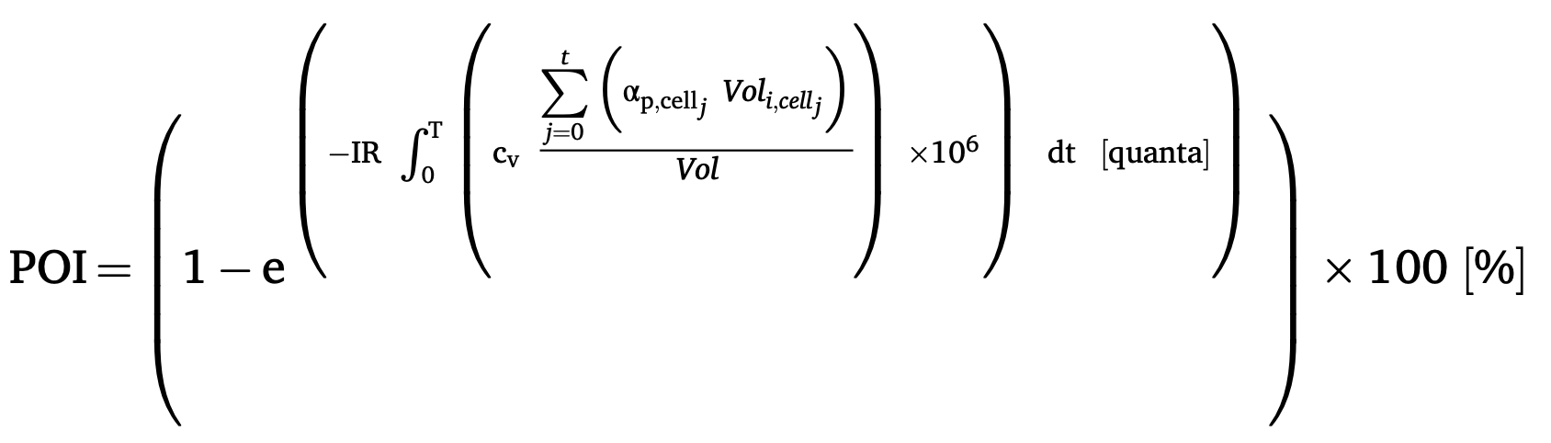
Probability of Infection (POI)
We employ a POI metric which accounts for the particle number, exposure duration, and clinical data. This metric computes the emission and distribution of infectious airborne particles carrying viral concentrations (quanta) within a room.
Volume fraction of particles to air
The initial hydrated volume of particles
Viral load 2.35 ×10⁹ [quanta/mL]
Inhalation rate [0.6 m³/h]

Slide 14
Case Study Description

Slide 15

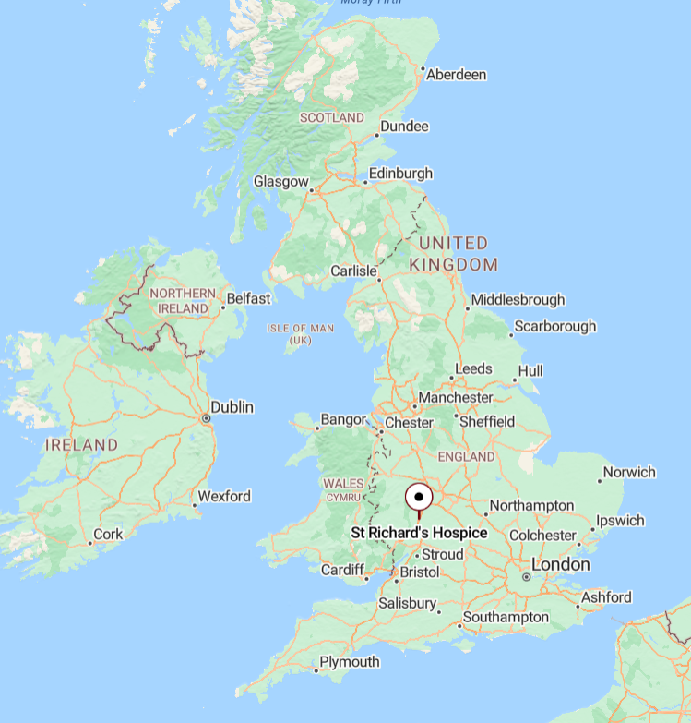

The Case Study
Main Entrance
The Green

Slide 16
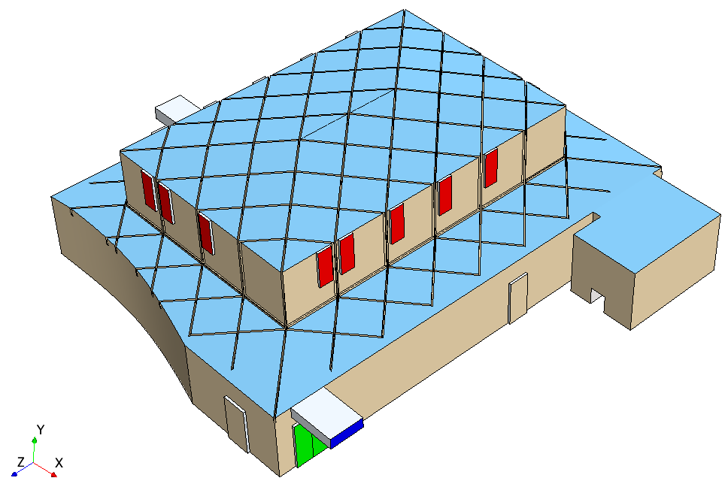
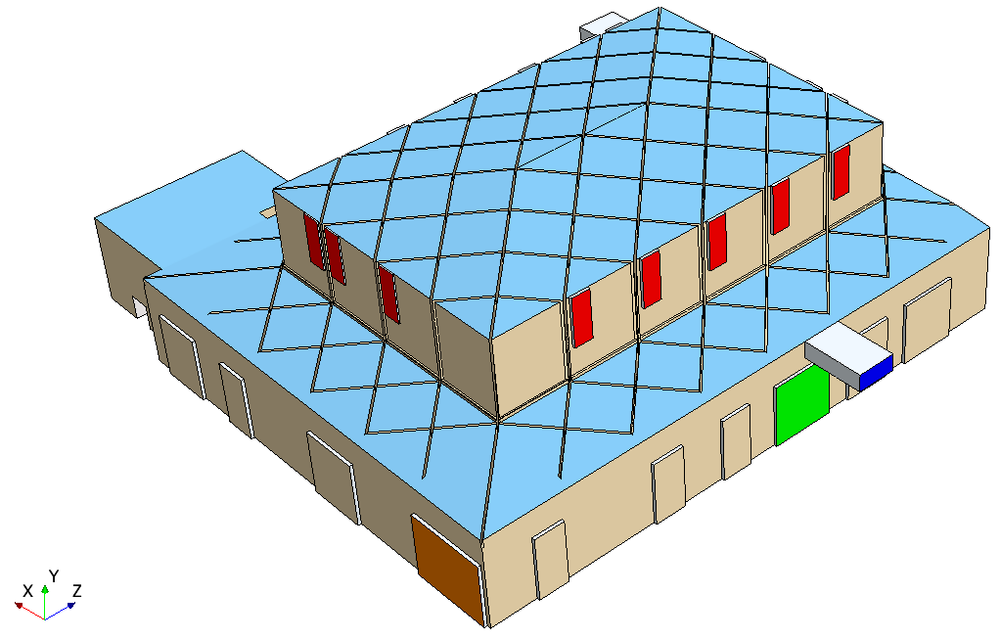
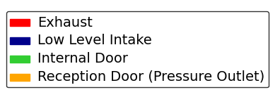
Geometry
View A
View B
View B
1
2
3
4
1
1
2
2

Slide 17
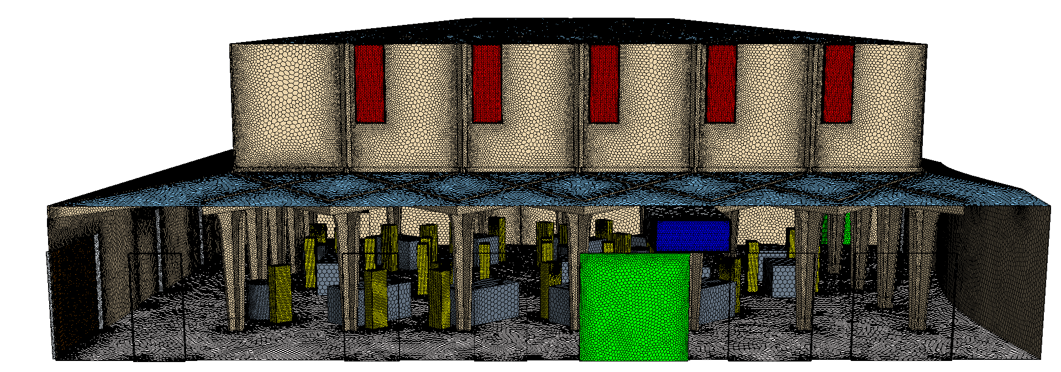
Mesh

Slide 18
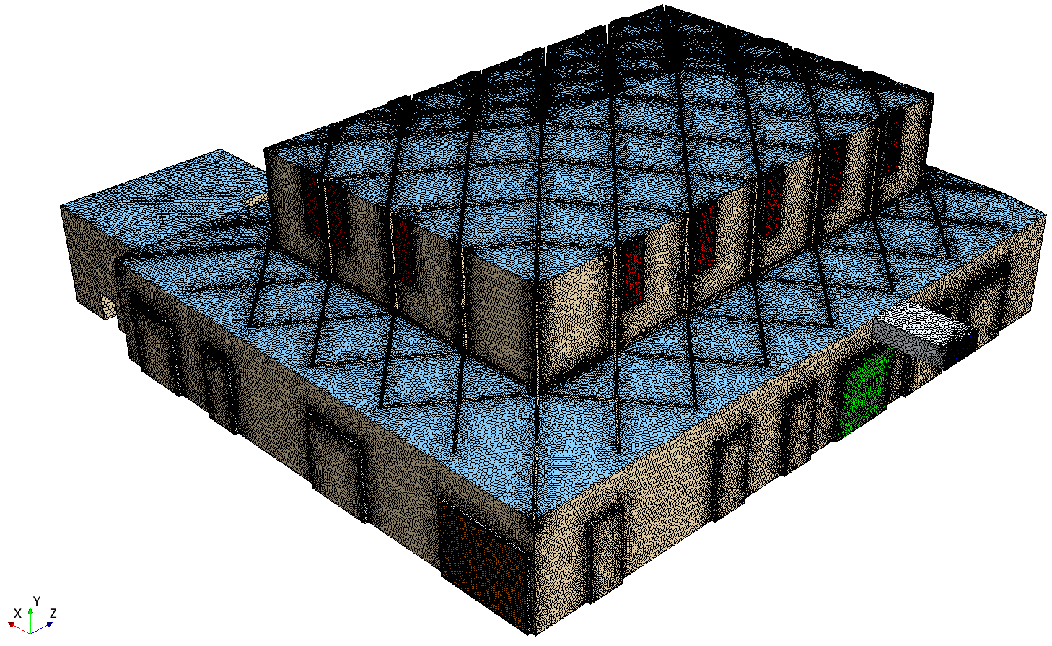
Mesh

Slide 19
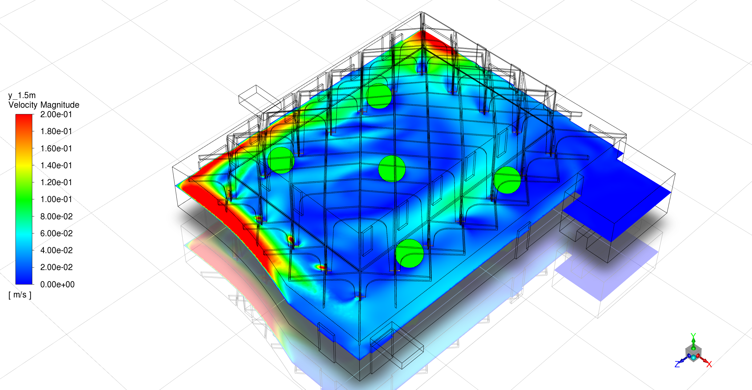
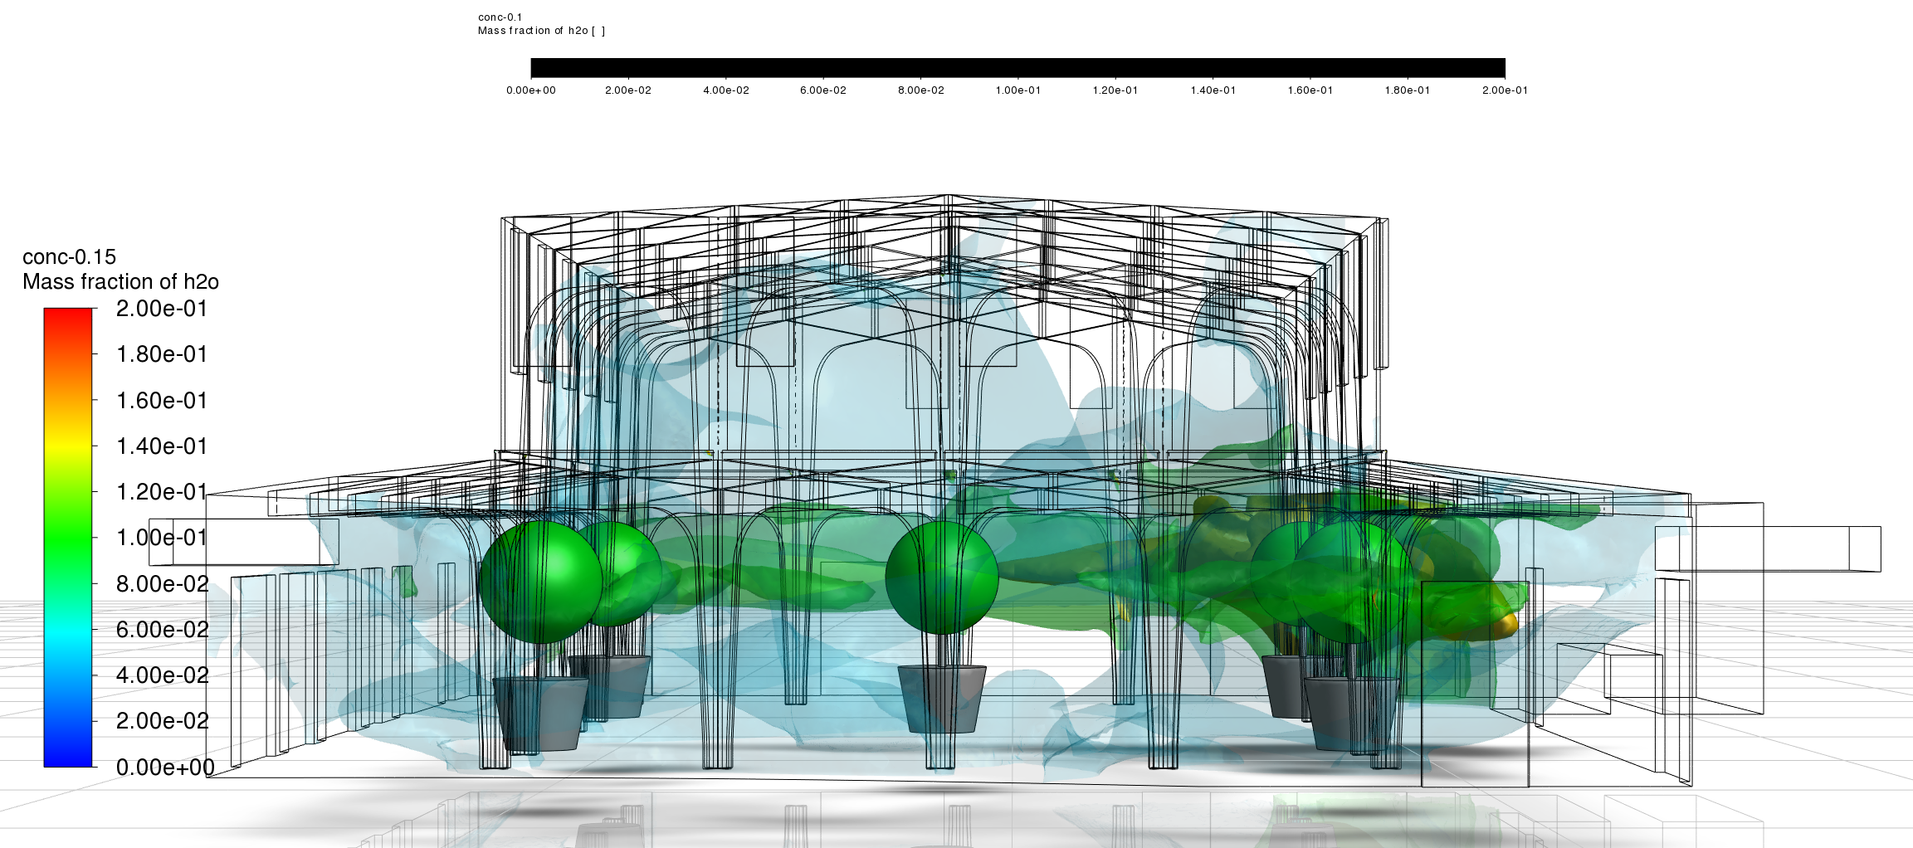
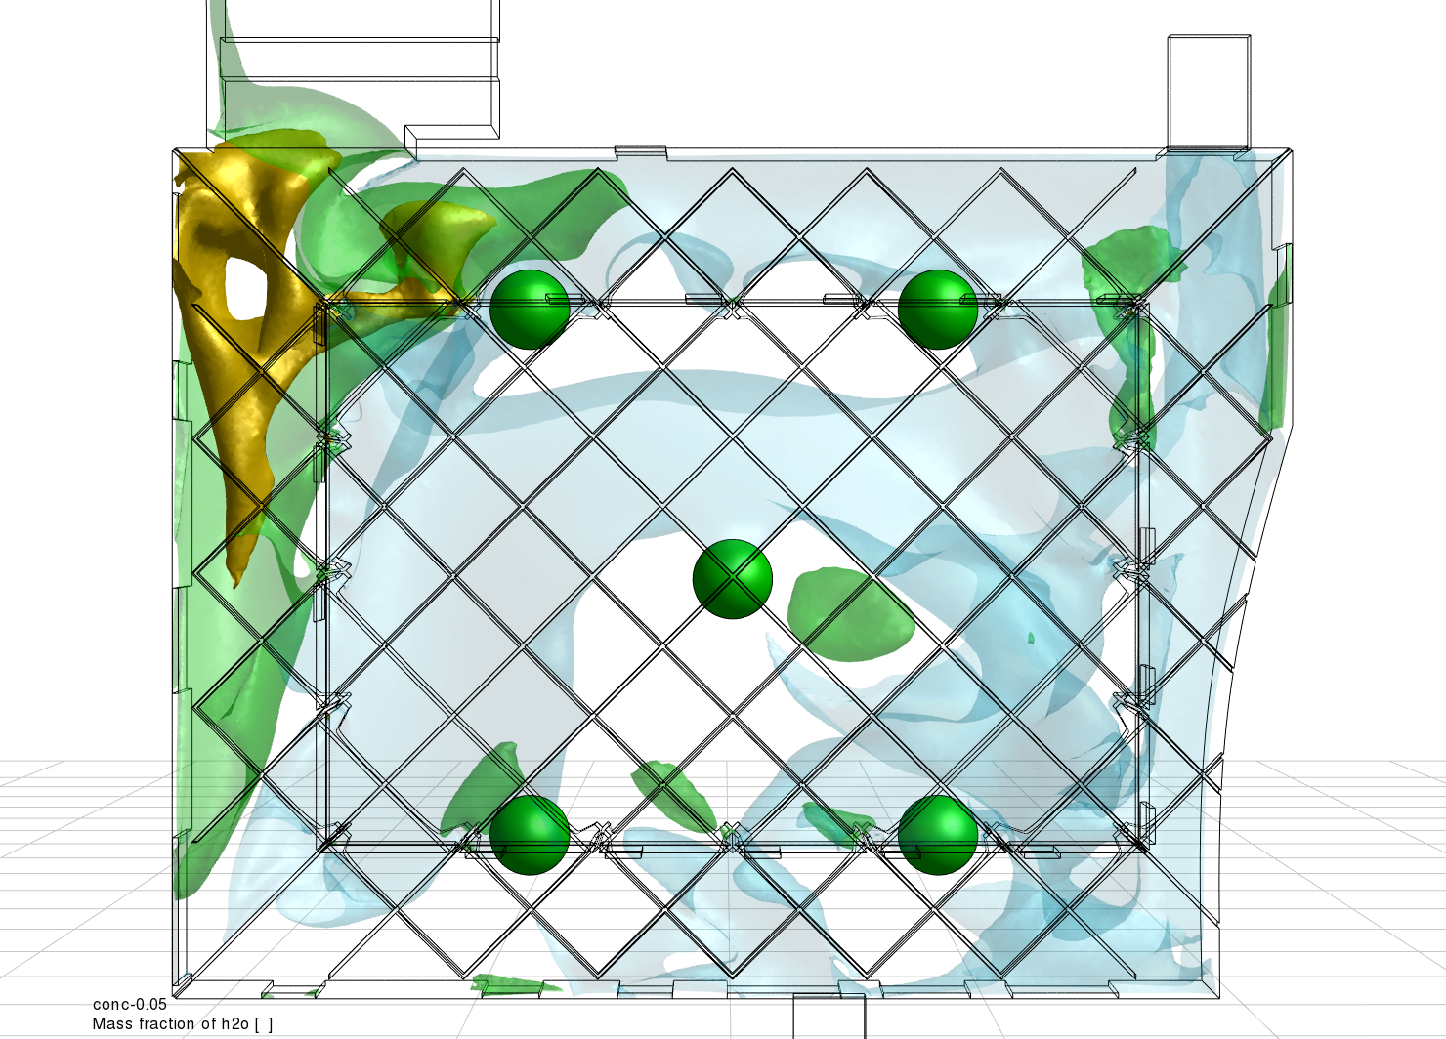
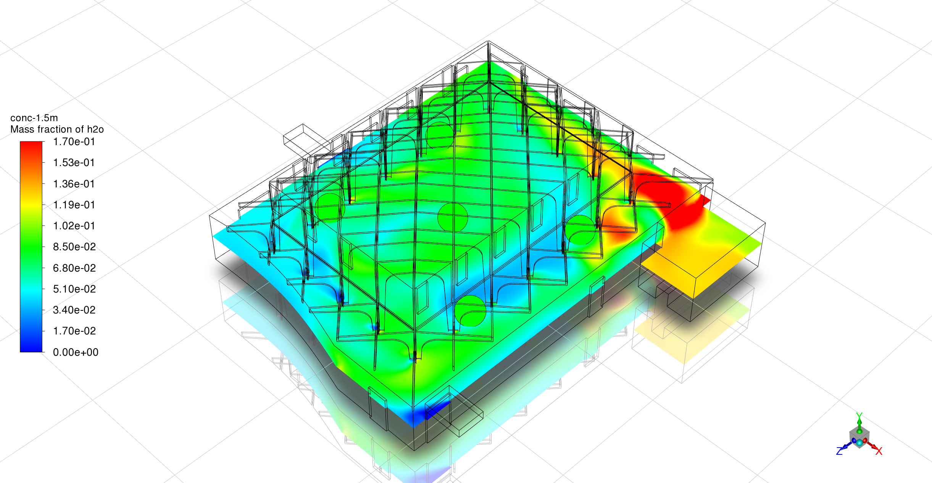
Initial CFD Results

Slide 20
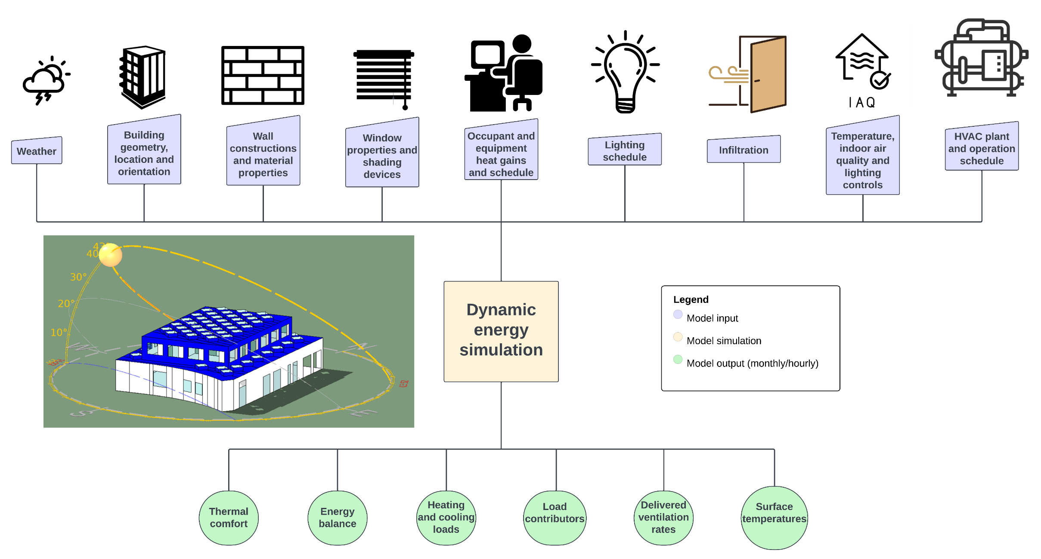
Energy Modelling

Slide 21
CFD vs Energy Modelling
 | Energy Modelling (IESVE) | CFD (Star-CCM+)
Spatial resolution | Buildings at zone level | Detailed single room/zone analysis
Temporal resolution | Annual at 1-15 min time-step | Several minutes/hours at seconds time step
Conservation equations | Quasi-steady energy and mass conservation | Navier-Stokes equations
Computing cost | Low | High

Slide 22
Validation

Slide 23
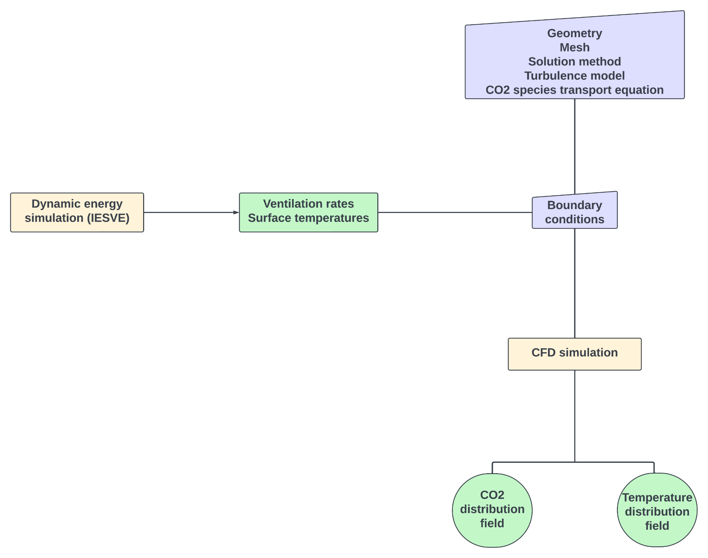
Validation Framework

Slide 24
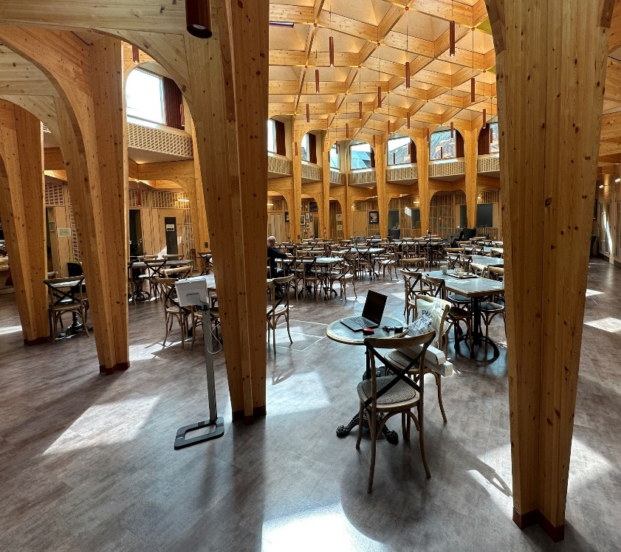
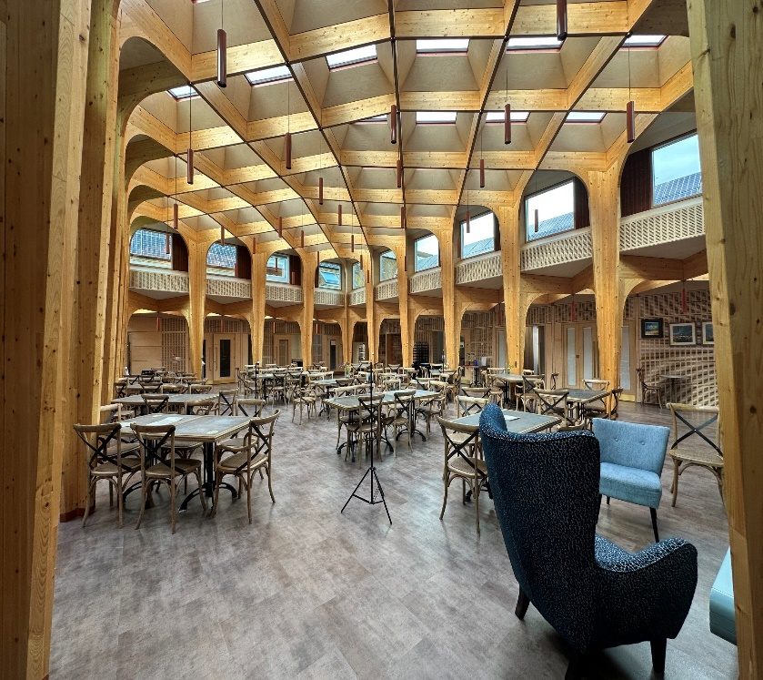
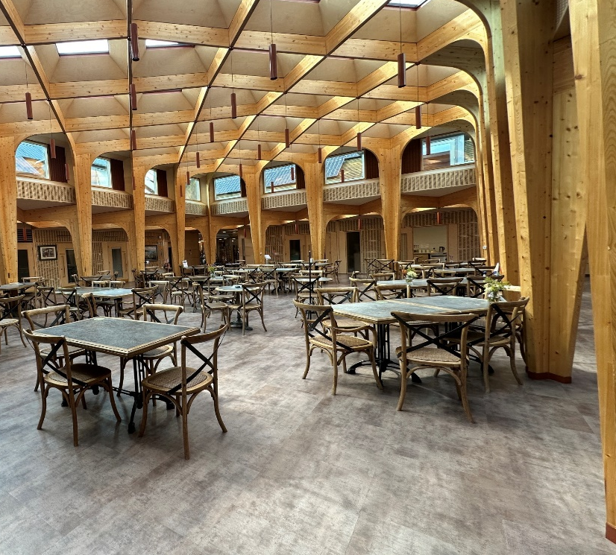
View A
Experimental Setup
View B
North Facing Wall
A
B
S1
S2
West Facing Wall
East Facing Wall
View D
S3
View C
S4
S5
S6
D
C
South Facing Wall

Slide 25
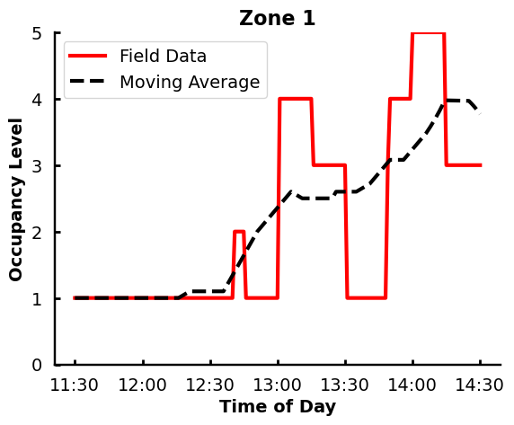
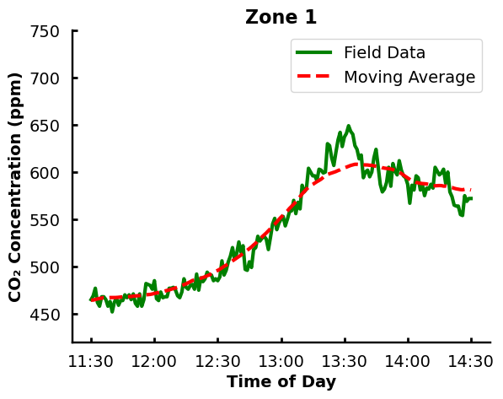
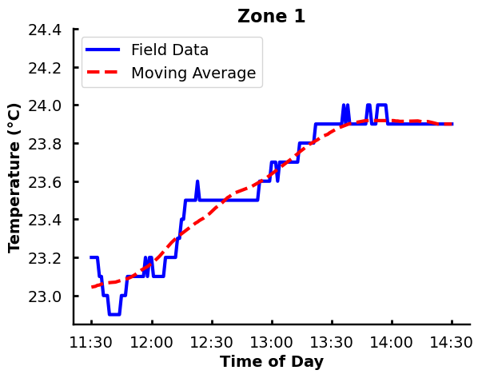
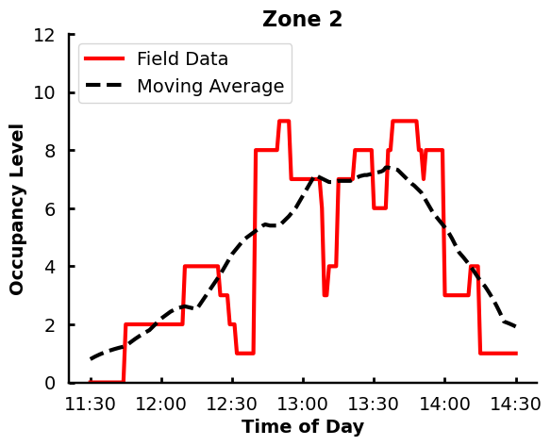
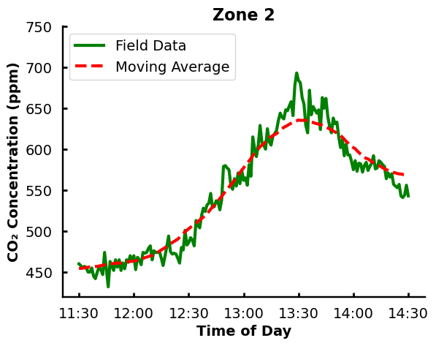
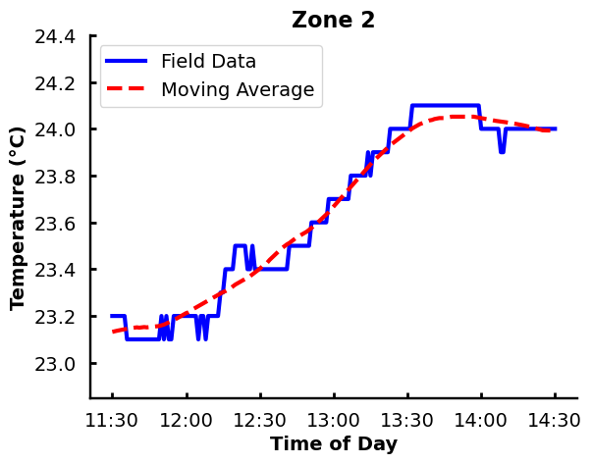

Slide 26
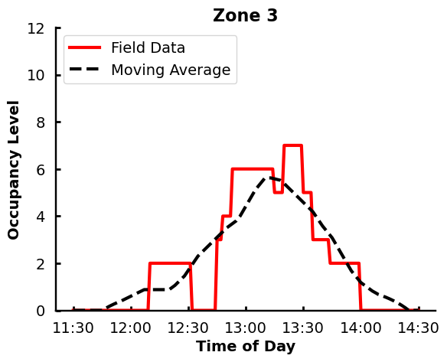
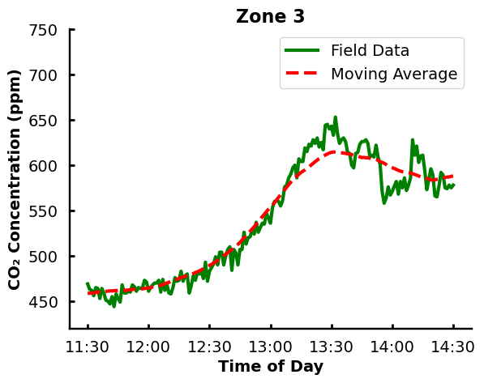
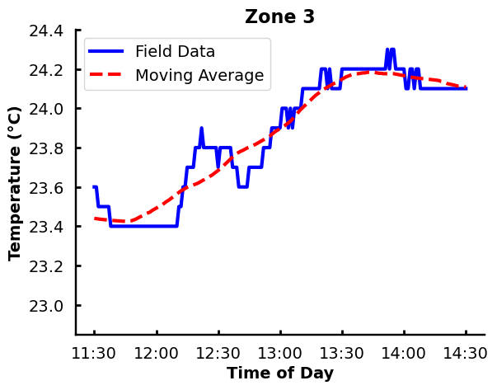
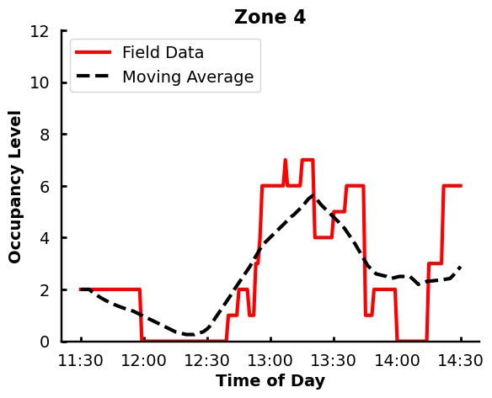
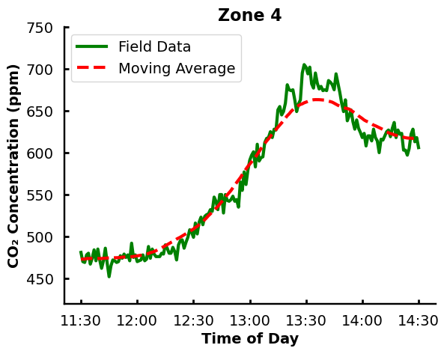
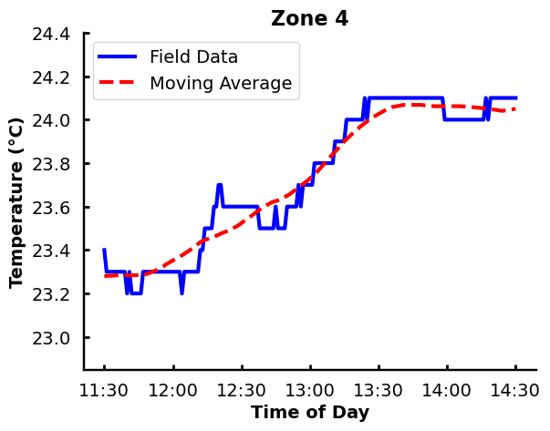

Slide 27
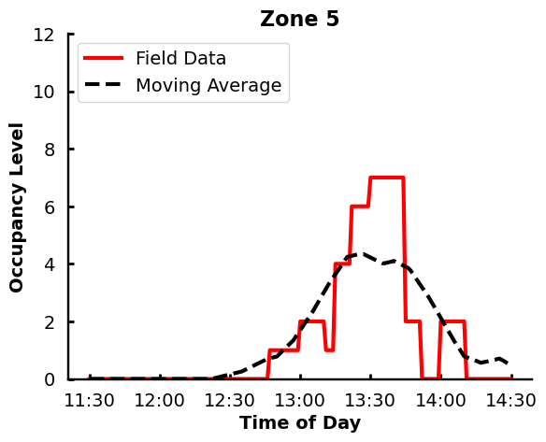
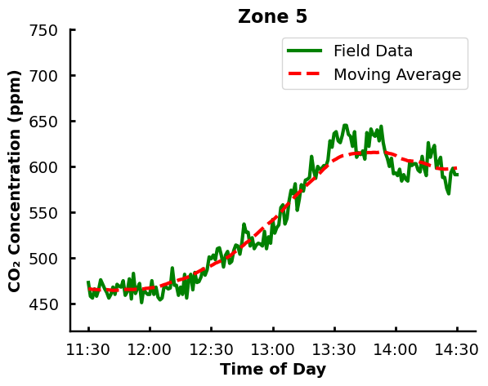
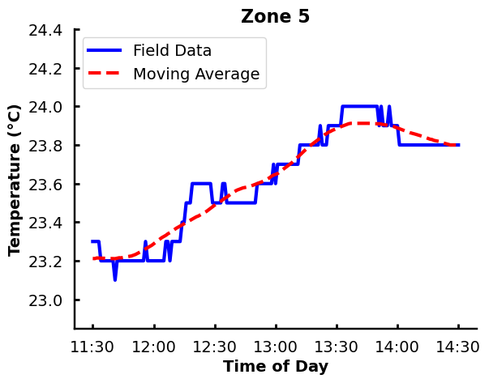
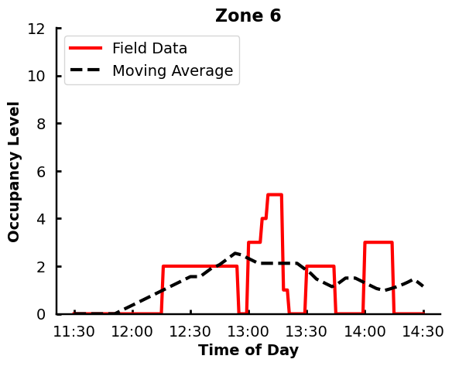
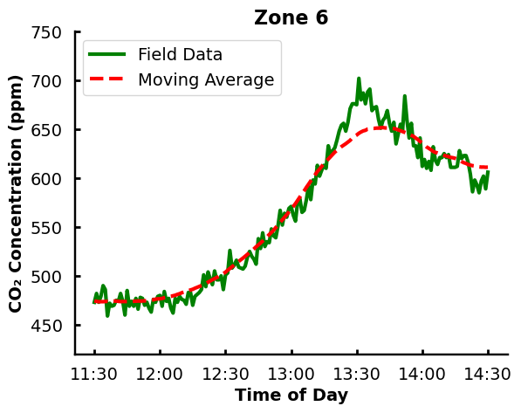
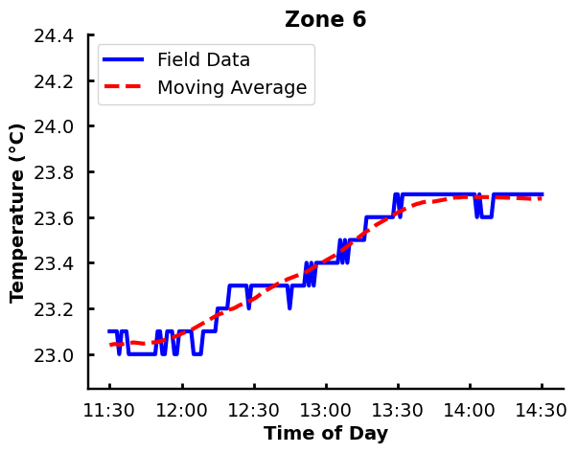

Slide 28
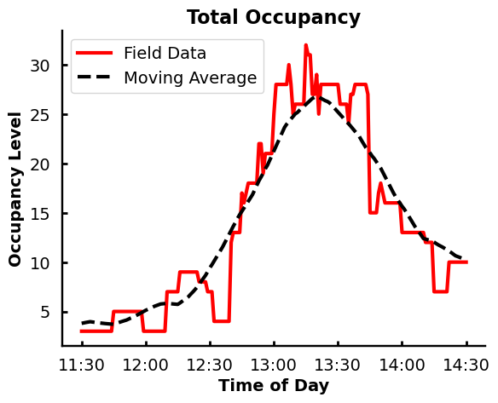
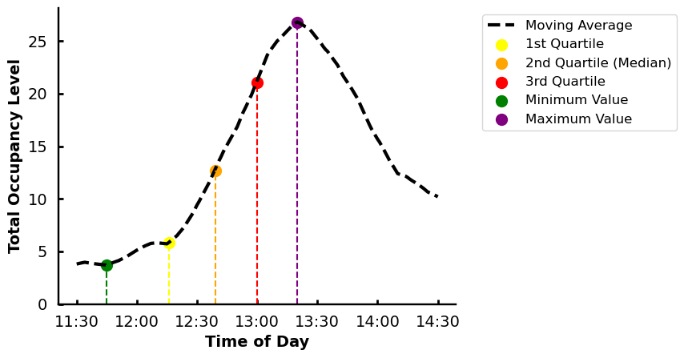
Validation Cases
Occupancy | Time of Day
Minimum | 11:45
Q1 | 12:16
Q2 | 12:39
Q3 | 13:00
Maximum | 13:20

Slide 29
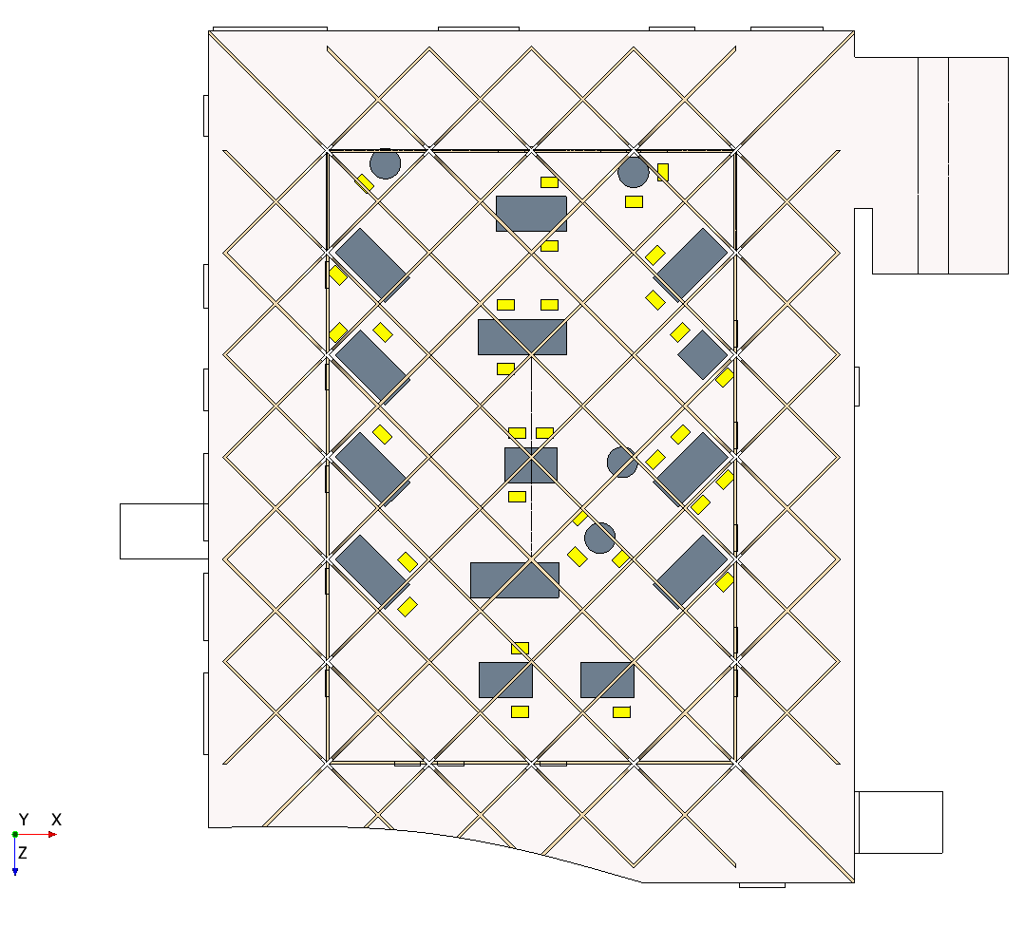
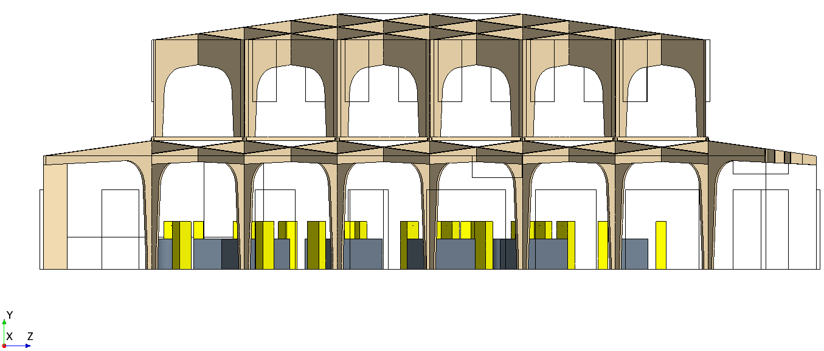
Peak Occupancy @ 13:20
32 occupants

Slide 30


Validation Boundary Conditions
Validation Boundary Conditions
 | E1 | E2 | E3 | E4 | Intake 1 | Intake 2 | Internal Door 1 | Internal Door 2
Ventilation Rate (kg/s) | 0.1031 | -0.1174 | -0.1065 | -0.0176 | -0.0469 | 0 | 0 | 0

Slide 31







Slide 32







Slide 33
Infection Risk Assessment

Slide 34


Generating Representative Cases
Challenge: Natural ventilation causes high variability (hour-to-hour, day-to-day) in airflow → difficult to capture with full-year CFD.
Approach:
  Full-year dynamic energy simulation (IES VE → 8,760 hrs of data)
  Statistical analysis of ventilation flow rates across all openings
  Python script identified 13 representative hours (min, max, median, Q1–Q3 across openings)
Benefit:
  Captures full statistical range of natural ventilation behaviour
  Reduces 8,760 hrs → 13 targeted CFD cases
  Ensures coverage of realistic operating conditions while keeping simulations.

Slide 35
Representative Cases: Boundary Conditions
Date | Time | Intake 1 | Intake 2 | E1 | E2 | E3 | E4 | ID1 | ID2 | Occupancy | Season
05/07/2023 | 17:30 | -0.04 | 1.01 | -0.33 | -0.5 | 0.89 | -0.05 | -0.51 | 1.39 | 50% | Summer
08/01/2023 | 12:30 | 0 | 0 | 0 | -0.09 | -0.17 | 0.35 | 0 | 0 | 100% | Winter
31/05/2023 | 06:30 | 0.37 | -0.38 | 0 | 0 | 0 | 0 | 0 | 0 | 25% | Summer
17/01/2023 | 15:30 | 0 | 0 | 0.12 | 0.64 | -0.38 | -0.26 | 0 | 0 | 50% | Winter
08/12/2022 | 08:30 | 0 | 0 | 0 | 0 | 0 | 0 | 0 | 0 | 50% | Winter
24/06/2023 | 07:30 | -0.2 | 0.25 | -0.01 | -0.01 | 0.01 | -0.03 | 0 | 0 | 50% | Summer
16/05/2023 | 16:30 | 0 | 0 | 0.04 | 0.21 | -0.09 | 0.12 | 0 | 0 | 50% | Summer
10/12/2022 | 19:30 | 0 | 0 | 0.11 | -0.07 | -0.05 | -0.02 | 0 | 0 | 100% | Winter
11/07/2023 | 15:30 | -0.07 | -0.36 | 0.5 | 0.31 | -0.42 | -0.16 | 0.5 | -1.25 | 50% | Summer
03/01/2023 | 19:30 | 0 | 0 | -0.09 | 0.23 | -0.04 | -0.03 | 0 | 0 | 100% | Winter
05/02/2023 | 09:30 | 0 | 0 | 0.07 | 0.08 | -0.07 | -0.07 | 0 | 0 | 100% | Winter
31/08/2023 | 18:30 | -0.05 | 0 | -0.08 | 0.02 | 0.13 | 0.05 | 0 | 0 | 50% | Summer
04/07/2023 | 14:30 | 0 | 0 | -0.09 | -0.41 | 1.07 | 0.04 | 0 | 0 | 50% | Summer
13 specific hourly cases across the year whose combined ventilation profiles span the full statistical range across all openings.

Slide 36

Number of Infectors
If we approximate the number of infectors as:
$$I=[α∗N]$$
where $α$ is the population prevalence rate and $N$ is the maximum design occupancy of the building application defined by CIBSE/ASHRAE. This is usually 10 m² of floor area per person.
$α$ is taken as 7% [Elsarraj et al 2025].
For this case study, N will be taken as the maximum occupancy level (counting seats) for worst case scenario (Full occupancy taken as 88).
Acceptable limit of Probability of Infection (POI) found as 7.5% [Elsarraj et al 2025].

Slide 37






Worst Case Infector Positions
Case A
Case B
Case C
Case D

Slide 38
Worst Case Infector Positions

Slide 39



Worst Case Infector Positions
Case K
Case L
Case M

Slide 40
Infection Risk vs CO₂ Concentration

Slide 41
Infection Risk vs CO₂ Concentration

Slide 42


Infection Risk vs CO₂ Concentration
If there is a high CO2 Concentration does not mean high infection risk as there can be no infectious particles in that region but there is still an occupant exhaling CO2. e.g Case B.
This is dependent on the infector position and the direction of airflow which both are extremely transient in practice.

Slide 43
Conclusion
Context: Hospices/hospitals house highly vulnerable individuals → airborne infection control is critical.
Problem with CO₂-only control: CO₂ concentration does not reliably represent infection risk.
Solution: Use Probability of Infection (POI) metric, derived from CFD simulations, to quantify airborne risk (0–100%).
Validation approach: Coupled CFD + energy model calibrated with real field data (CO₂, temperature, wall conditions, airflow).
Representative use cases: 13 scenarios from year-long ventilation data captured realistic airflow patterns and worst-case infector positions.
Findings: POI-based thresholds recommend earlier window opening:
  Begin at 500 ppm
  Fully open at 600 ppm
  Linear control within ±50 ppm
Impact: Compared to pre-pandemic 950 ppm threshold, new strategy reduces infection risk while adding only 8% heating demand.
Takeaway: Infection risk (IR) metrics provide a more reliable, representative basis for ventilation control than CO₂ alone, ensuring safety without major energy penalties.

Slide 44









Tel: +44 (0) 161 529 3514
www.ManchesterCFD.co.uk
info@ManchesterCFD.co.uk

